Slide 1
Research indicates that languages shape temporal perceptions in both subtle and not so subtle ways.

Slide 2

Resolution of grammatical tense into actual time, and its application in Time Perspective study in the tweet space
Sabyasachi Kamila, Mohammad Hasanuzzaman, Asif Ekbal, Pushpak Bhattacharyya
Published on PLOS ONE, approved in February 2019
Gian Carlo L. Baldonado
October 27, 2022

Slide 3
Agenda
Introduction
Time Perspective (TP)
Measuring TP
Contributions
Methods
Part I
Part II
Datasets
Training set
User-level test set
Results
Results of temporal orientation classification
Results of user-level TP
Correlation results and discussion
Limitation and future scope
Conclusion

Slide 4

Introduction
Time Perspective (TP): the study of how individuals divide the flow of human experience into different time frames or time zones – automatically and non-consciously.
Varies between individual’s upbringing, socialization, culture, education.
In turn, TP is influential and is proven by previous studies to impact behavior, attitudes, emotions, educational achievements, and so on.
E.g., A kid delays immediate gratification with a promise of getting more candies on Halloween. The kid could be described as to have a “future-oriented” time perspective.
Photo: MEDIAPHOTOS / GETTY IMAGES
Notes:
Examples:
Past-oriented: a friend avoids a restaurant because it reminds them of their ex.
Present-oriented: - mmediate situtation - you decide to take in your biggest fear of riding a roller coaster and go to Six Flags.

Slide 5
Measuring TP
Uni-dimensional TP
Past
Present
Future
Unidimensional TP vs Bidimensional TP
Zimbardo Time Perspective Inventory (ZTPI) is the most common measure of TP
ZTPI considers TP as bi-dimensional construct:
temporal orientation (past, present, future)
valence dimension (positive, negative, neutral)
Language-based assessments using NLP.
Twitter allows easy access to vast amount of text for research via tweets.
Problem: syntactic tense does not always equate to semantic time.
“I need your help in the upcoming activity of our group.”
The tense is present, but the intended temporal orientation is future.
The paper proposes a robust method that would be able to capture actual temporal orientation from sentences automatically.
Bi-dimensional TP
Past Positive
Past Neutral
Past Negative
Present Positive
Present Neutral
Present Negative
Future Positive
Future Neutral
Future Negative
Notes:
Traditionally, assessed by self-report questionnaires, most commonly by ZimbardoTime Perspective Inventory.
Unidimensional TP from social media language has been studied.
E.g., TP correlated with different user attributes (e.g., age, gender, IQ, satisfaction with life, personality traits, etc.)
Unidimensional TP vs Bidimensional TP from social media language has been studied.
E.g., Uni-TP correlation with different user attributes (e.g., age, gender, IQ, satisfaction with life, personality traits, etc.)
On the contrary, this paper is interested in both unidimensional and bidimensional aspects of TP from tweets.
Unidimensional TP only accounts for temporal orientation (past, present, future). Hence, bidimensional TP can give us better insights into human attributes.
Past TP – Focus on Positives
“It gives me pleasure to think about the past”
Past TP – Focus on Negatives
“I think about bad things that have happened to me in the past”
Present TP – Hedonism
“Taking risks keeps my life from becoming boring.”
Present – Fatalism
“Often luck pays off better than hard work.”
Future
“I complete projects on time by making steady progress.”

Slide 6
Contributions
A summary
Present a method to resolve grammatical tense of users’ tweets into actual time by measuring temporal orientation from tweets.
Propose a minimally supervised approach for temporal orientation framework that leverages a large quantity of unlabeled data and requires no hand-annotated training corpora.
Use this method to get the temporal orientation from tweets for a large number of Twitter users and then aggregate over users to obtain users’ unidimensional-TP.
Introduce the valence dimension to assess user’s bidimensional-TP.
Explore relationship between Twitter users’ TP and demographics and six basic emotions on a large scale.

Slide 7
Method Overview
Part I
Extract temporal orientation from tweets via attention-based bi-LSTM network with linguistic feature embedding,
Part II
Measure the correlations between users’ TP and their age, education, and six basic emotions.
Measure user-level TP

Slide 8
Method – Part I
Extracting temporal orientation from tweets,
attention-based bi-LSTM network with linguistic feature embedding,
word-level features, merged output layer, and model parameters
Notes:
Created training data for classification by aggregating tweets based on Twitter’s hashtag information
A temporal orientation classifier classifies user-level tweets into either of past, present, or future categories.
Tweets classified in this way are then grouped for each user to get user-level unidimensional TP.
Then, a pre-trained sentiment classifier further classifies the tweets of each temporal category into positive, negative and neutral and give rise to 9-factor scale:
Past-Positive, Past-Negative, Past-Neutral,
Present-Positive, Present-Negative, Present-Neutral,
Future-Positive, Future-Positive, Future-Neutral

Slide 9
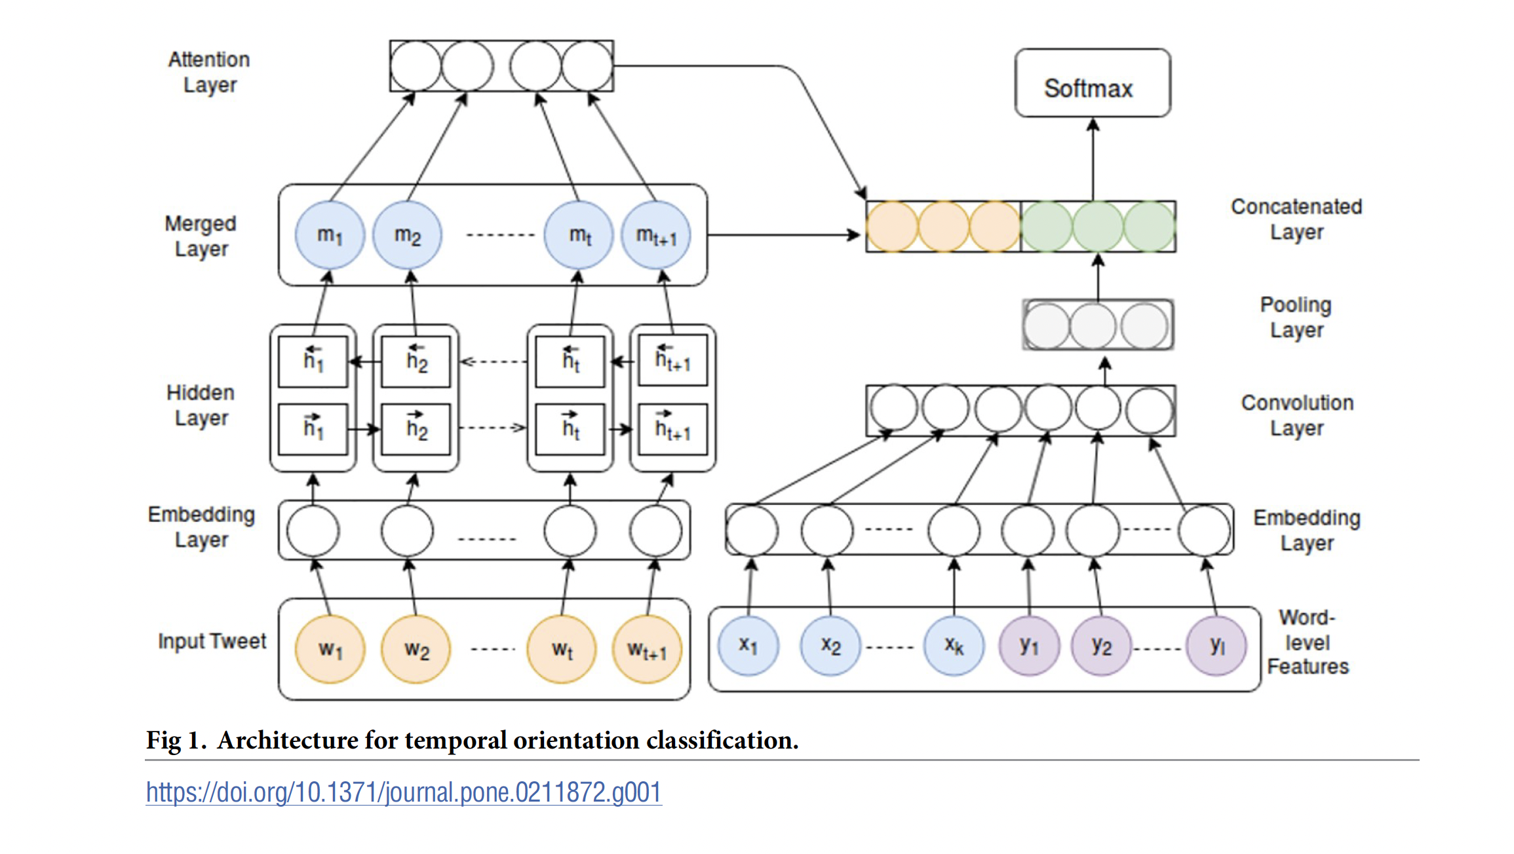

Slide 10
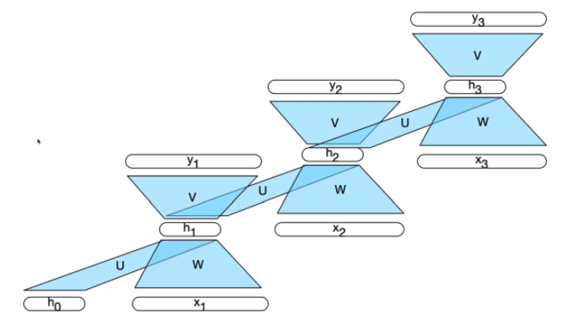
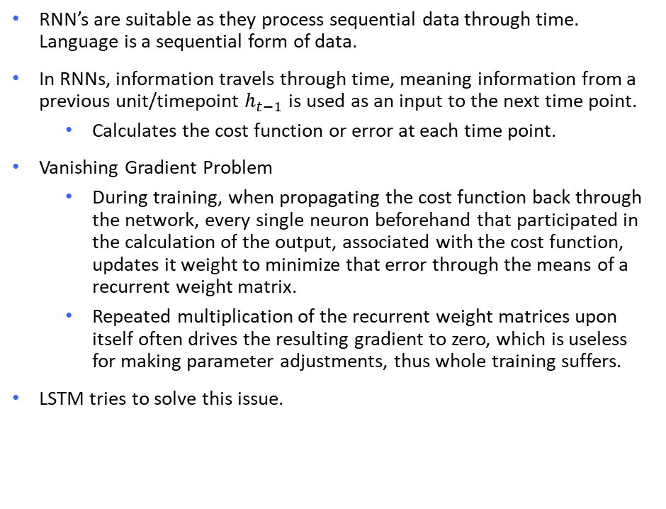
Recap of RNNs and Vanishing Gradient Problem
RNN’s are suitable as they process sequential data through time. Language is a sequential form of data.
In RNNs, information travels through time, meaning information from a previous unit/timepoint $h_{t−1}$ is used as an input to the next time point.
Calculates the cost function or error at each time point.
Vanishing Gradient Problem
During training, when propagating the cost function back through the network, every single neuron beforehand that participated in the calculation of the output, associated with the cost function, updates it weight to minimize that error through the means of a recurrent weight matrix.
Repeated multiplication of the recurrent weight matrices upon itself often drives the resulting gradient to zero, which is useless for making parameter adjustments, thus whole training suffers.
LSTM tries to solve this issue.
A simple RNN
$h_{i}=g(Uh_{i−1}+Wx_{t−1}$) where g is a non-linear activation function.
Screenshot from Professor Anagha Kulkarni’s Spring 2022 NLP lecture.
Notes:
H_1 is called a hidden time step
Recap RNN: A neural network architecture that
Presents one input item at a time to a network and contains one or more cycles within its network connections
Cycle – a network wher the value of a unity is directly or idirectly dependent on its own earlier outputs as an input
Useful for variable-length sequential data
Hidden layter from previous time step lifts restriction of a fixed-length prior context – therefore greater context like a saved memory.
Recall back propagation: differentiation using computation graphs to update the parameters
Partial derivatives of loss function
Problems with RNN
Hidden layers expected to perform two distinct tasks at the same time:
Provide iunfo useful for current decision
Update and carry forward info required for future decisions
RNNs have to carry both info in the same place…can cause vanishing gradient problems.
Vanishing gradient problem
In the training phase, the process of back-propogation through time requires repeated multiplication of the gradients (one for each time step in other words, the length of the sequence). Often this drives the resulting gradient to zero thus rendering it useless for making parameter adjustments.

Slide 11
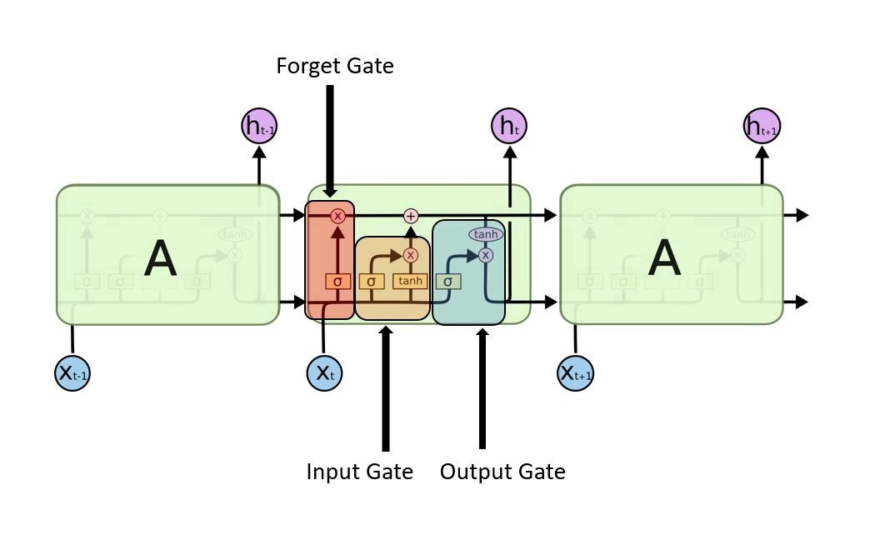
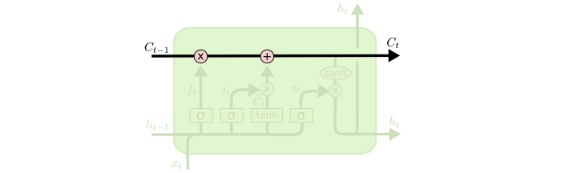
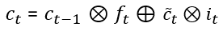
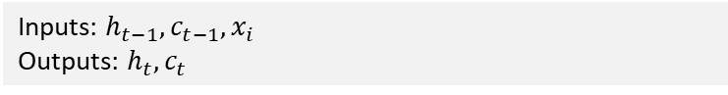
LSTM
LSTM network
Long Short-Term Memory (LSTMs), a special kind of RNN.
LSTMs have internal gates, composed of sigmoid neural network and pointwise multiplication operation, that regulate the flow of information. These gates can learn which data in a sequence is important to keep or throw away.
Useful for learning long-term dependencies in the text:
E.g., “Working in the same unit today with different staffs was so much better”
LSTMs get their leverage from the cell state, a path in which information can pass easily with some minor liner operations. Gates can add or remove information from the cell state. The key player in minimizing risks of a vanishing gradient in LSTMs when backpropagating errors.
Image taken from https://colah.github.io/
Inputs: $h_{t−1}, c_{t−1}, x_{i}$
Outputs: $h_{t}, c_{t}$
Image taken from https://colah.github.io/
Notes:
have internal gates that regulate the flow of information. These gates can learn which data in a sequence is important to keep or throw away.
divides context management problem into 2 sub-problems:
Remove information no longer needed from context
Add information likely to be needed later for decision making.
LSTM does this by adding a new layer dedicated to capturing context using specialized neural units that use gates to control info flow
Bi-directional LSTM solves the problem with regular RNN for sequence calssification. The rerpresentation of the input sequence tends to reflect more information about the ewnd of the sequencerather than thstart.

Slide 12
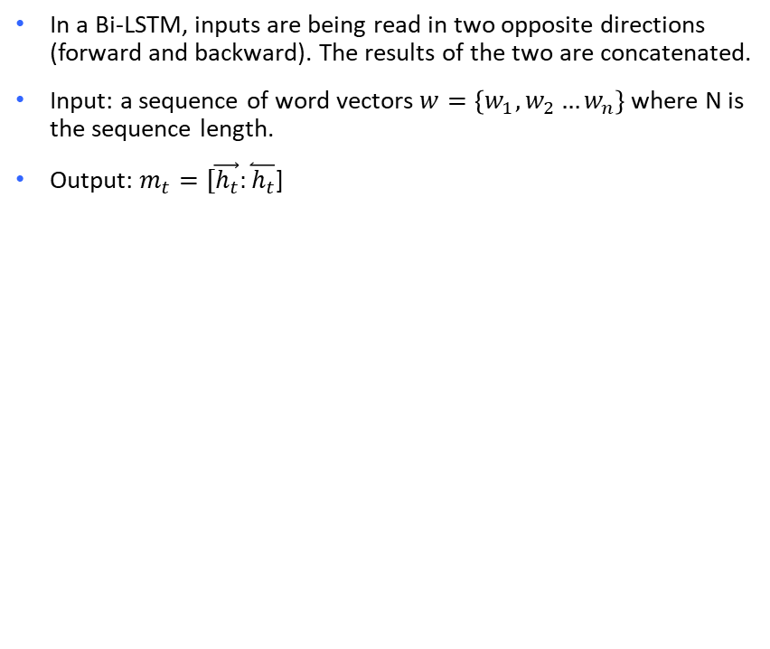
Bi-LSTM
In a Bi-LSTM, inputs are being read in two opposite directions (forward and backward). The results of the two are concatenated.
Input: a sequence of word vectors $w=\left\{w_{1},w_{2}…w_{n}\right\}$ where N is the sequence length.
Output: $m_{t}=[\vec{h_{t}}:\overset{⃐}{h_{t}}$]
Notes:
Bi-directional LSTM solves the problem with regular RNN for sequence calssification. The rerpresentation of the input sequence tends to reflect more information about the ewnd of the sequencerather than thstart.

Slide 13
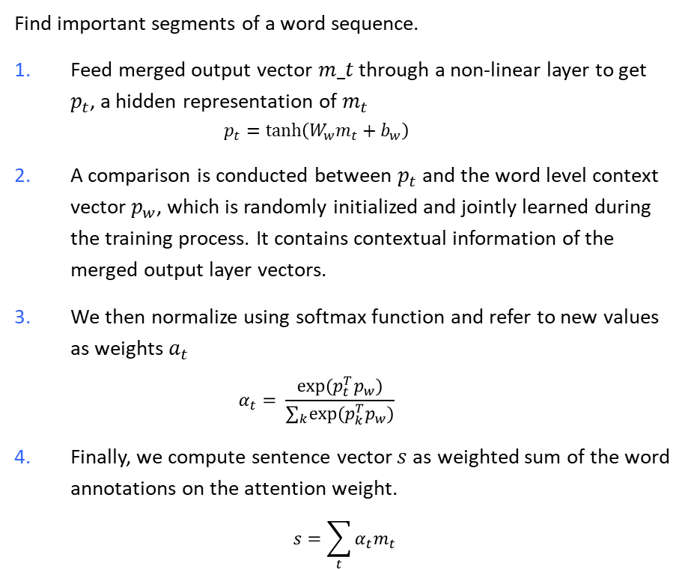
Attention network
Find important segments of a word sequence.
Feed merged output vector $m_t$ through a non-linear layer to get $p_{t}$, a hidden representation of $m_{t}$
$$p_{t}=\tanh\left(W_{w}m_{t}+b_{w}\right)$$
A comparison is conducted between $p_{t}$and the word level context vector $p_{w}$, which is randomly initialized and jointly learned during the training process. It contains contextual information of the merged output layer vectors.
We then normalize using softmax function and refer to new values as weights $a_{t}$
$$α_{t}= \frac{exp⁡(p_{t}^{T}p_{w})}{∑_{k}exp⁡(p_{k}^{T}p_{w})}$$
Finally, we compute sentence vector$s$as weighted sum of the word annotations on the attention weight.
$$s=\sum_{t}{α_{t}m_{t}}$$
Notes:
Not all words contribute equally to the representation of the sentence meaning. Hence, we introduce attention mechanism to extract such words that are important to the meaning of the sentence and
Find important segments of a word sequence by aggregating the representation of those informative words to form a sentence vector.
That is, we first feed the word annotation hit through a one-layer MLP to get uit as a hidden representation of hit, then we measure the importance of the word as the similarity of uit with a word level context vector uw and get a normalized importance weight αit through a softmax function. After that, wecompute the sentence vector si (we abuse the notation here) as a weighted sum of the word annotations based on the weights. The context vector uw can be seen as a high level representation of a fixed query “what is the informative word” over the words like that used in memory networks (Sukhbaatar et al., 2015; Kumar et al., 2015). The word context vector uw is randomly initialized and jointly learned during the training process

Slide 14
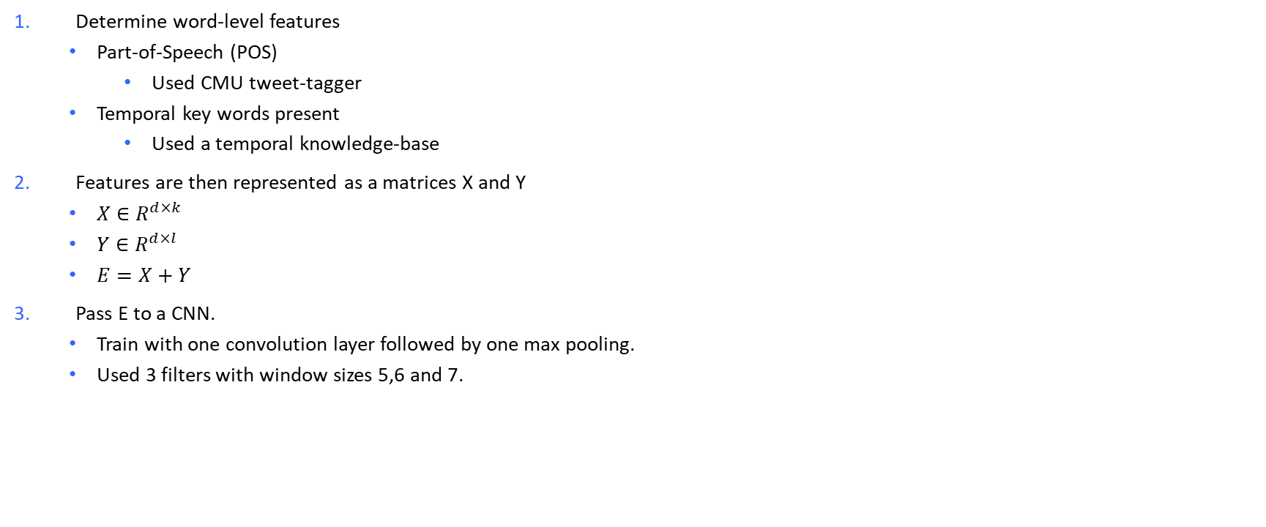
Word-level features
Determine word-level features
Part-of-Speech (POS)
Used CMU tweet-tagger
Temporal key words present
Used a temporal knowledge-base
Features are then represented as a matrices X and Y
$X∈R^{d×k}$
$Y∈R^{d×l}$
$E=X+Y$
Pass E to a CNN.
Train with one convolution layer followed by one max pooling.
Used 3 filters with window sizes 5,6 and 7.
Notes:
CNN a type of neural network common in use with computer vision to recognize objects and patterns in images. One of their defining traits is use of filters within convolutional layers.
A filter is simply a matrix of randomized number values.
Pooling: main purpose is to reduce the size of a feature map.
Maximum pooling, or max pooling, is a pooling operation that calculates the maximum, or largest, value in each patch of each feature map. The results are down sampled or pooled feature maps that highlight the most present feature in the patch, not the average presence of the feature in the case of average pooling.
→ WHY to help prevent over-fitting by providing an abstracted form of the representation. IT reduces computational cost by reducing the number of parameters to learn and provide basic translation invairance to the itnernal presentation.

Slide 15
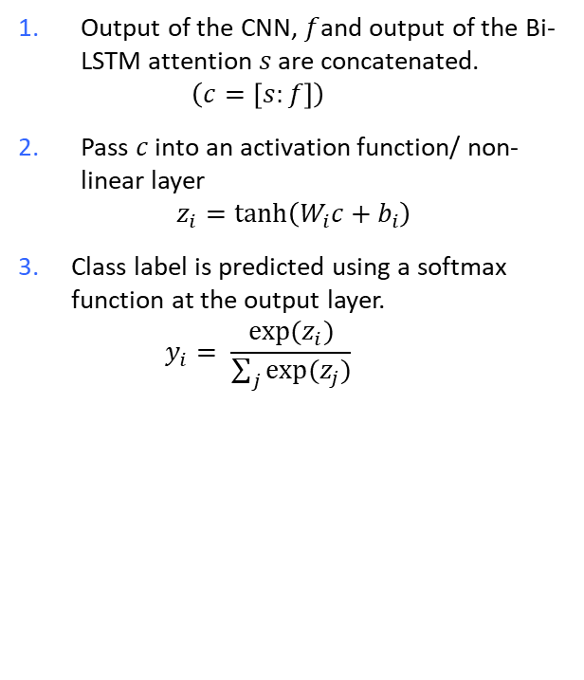
Merged Output Layer
Output of the CNN, $f$and output of the Bi-LSTM attention $s$ are concatenated.
$$\left(c=\left[s:f\right]\right)$$
Pass $c$ into an activation function/ non-linear layer
$$z_{i}=\tanh\left(W_{i}c+b_{i}\right)$$
Class label is predicted using a softmax function at the output layer.
$$y_{i}= \frac{exp⁡(z_{i})}{\sum_{j}{exp⁡(z_{j})}}$$

Slide 16
Model Parameters
Loss function: categorical cross-entropy
Optimizer: Root Mean square Propagation (rmsprop)
Epochs: 100
Batch size: 128
Dropout rate for regulation: 0.2
Prevent overfitting
* All parameters are finalized and tuned with 10-fold Cross Validation using grid-search.
Words are searched in pre-trained Stanford’s GloVe vector model (trained with 2 billion tweets containing 27 billion tokens).
Validated with validation set – 10% of the training.
Notes:
Categorical crossentropy is a loss function that is used in multi-class classification tasks. These are tasks where an example can only belong to one out of many possible categories, and the model must decide which one. Formally, it is designed to quantify the difference between two probability distributions.
Batch size refers to number of samples processed before the model is updated. The number of epochs is the nubmer of complete passes through the training datset.
Dropout is a regularization technique for reducing overfitting in neural networks by preventing complex co-adaptations on training data. It is a very efficient way of performing model averaging with neural networks. The term "dropout" refers to dropping out units (both hidden and visible) in a neural network.

Slide 17
Method – Part II
Measuring user-level TP
Correlation study

Slide 18
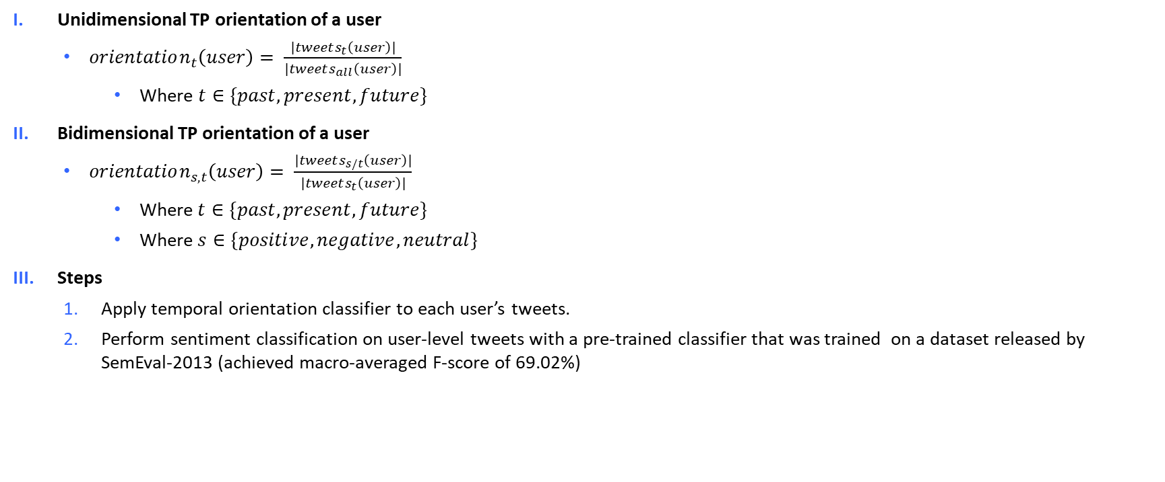
Measuring user-level TP
Unidimensional TP orientation of a user
$orientation_{t}\left(user\right)= \frac{|tweets_{t}\left(user\right)|}{|tweets_{all}\left(user\right)|}$
Where $t∈\{past, present, future\}$
Bidimensional TP orientation of a user
$orientation_{s, t}\left(user\right)= \frac{|tweets_{s/t}\left(user\right)|}{|tweets_{t}\left(user\right)|}$
$\text{Where} t∈\{past, present, future\}$
$\text{Where} s∈\{positive, negative, neutral\}$
Steps
Apply temporal orientation classifier to each user’s tweets.
Perform sentiment classification on user-level tweets with a pre-trained classifier that was trained on a dataset released by SemEval-2013 (achieved macro-averaged F-score of 69.02%)

Slide 19
Correlation Study
Used linear regression model to measure correlation between users’ TP with the following:
Age
Education
Joy
Sadness
Disgust
Surprise
Anger
Fear

Slide 20
Datasets
Training set
45,000 English tweets
Equal class distribution between past, present and future
To create this large training set, a hashtag-based minimally supervised method comprising of two filters was used:
Tweets with no verbs are filtered out
Most of the past oriented tweets shall contain a verb of the past tense.
Test set
741 manually annotated English tweets
Class distribution: 375 past, 164 present, 202 future
User-level test set
Consists of ~10 million English tweets from 5,191 users from the UK mapped to their user-level age, education, and six basic emotion features: joy, sadness, disgust, surprise, anger, and fear.
Used for the correlation study in the paper.
Notes:
Used hashtags to weakly label tweets as past, present, and future based on the following hypotheses:
WHY? The underlying hypothesis is that If a trending topic is a future/past/prevent event, then people would write mostly futuristic/past-oriented/present-oriented tweets.
WHY use filter? The most difficult to handle are present incidents as people sometimes refer to the past or provide opinion on the future effect.

Slide 21
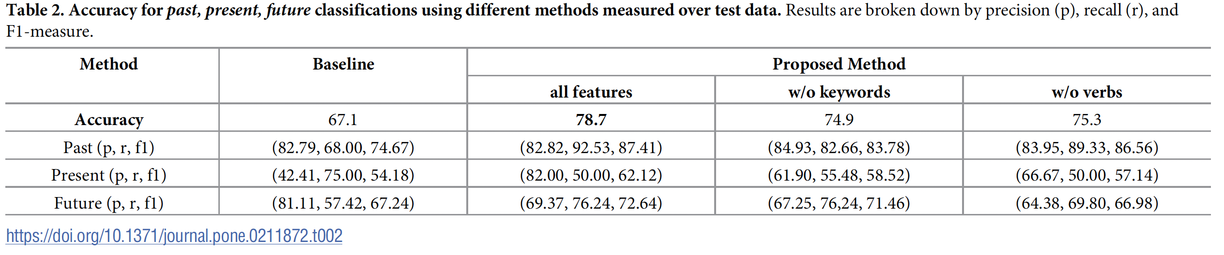
Results
Results of temporal orientation classification
Highlights
Best result uses proposed method, all features with accuracy of 78.7
Classifier most effective in classifying past class, followed by future and present
Low recall for present class
Future class mostly misclassified into past
Further analysis show that using tense information alone resolved only 21.6% of the test tweets’ time information.
Overall, the temporal orientation classifier is able to disambiguate between time information and tense information for 77.3% of test tweets.
Notes:
Results of temporal orientation classification
Highlights
Best result uses proposed method, all features with accuracy of 78.7
Classifier most effective in classifying past class, followed by future and present
Low recall for present class --> misclassified into past or future classes
Words in the tweet which represent present tense are not in the right form (Its, theres)
Future class mostly misclassified into past
Mainly because of presence of past verbs
Further analysis show that using tense information alone resolved only 21.6% of the test tweets’ time information.
Overall, the temporal orientation classifier is able to disambiguate between time information and tense information for 77.3% of test tweets.

Slide 22
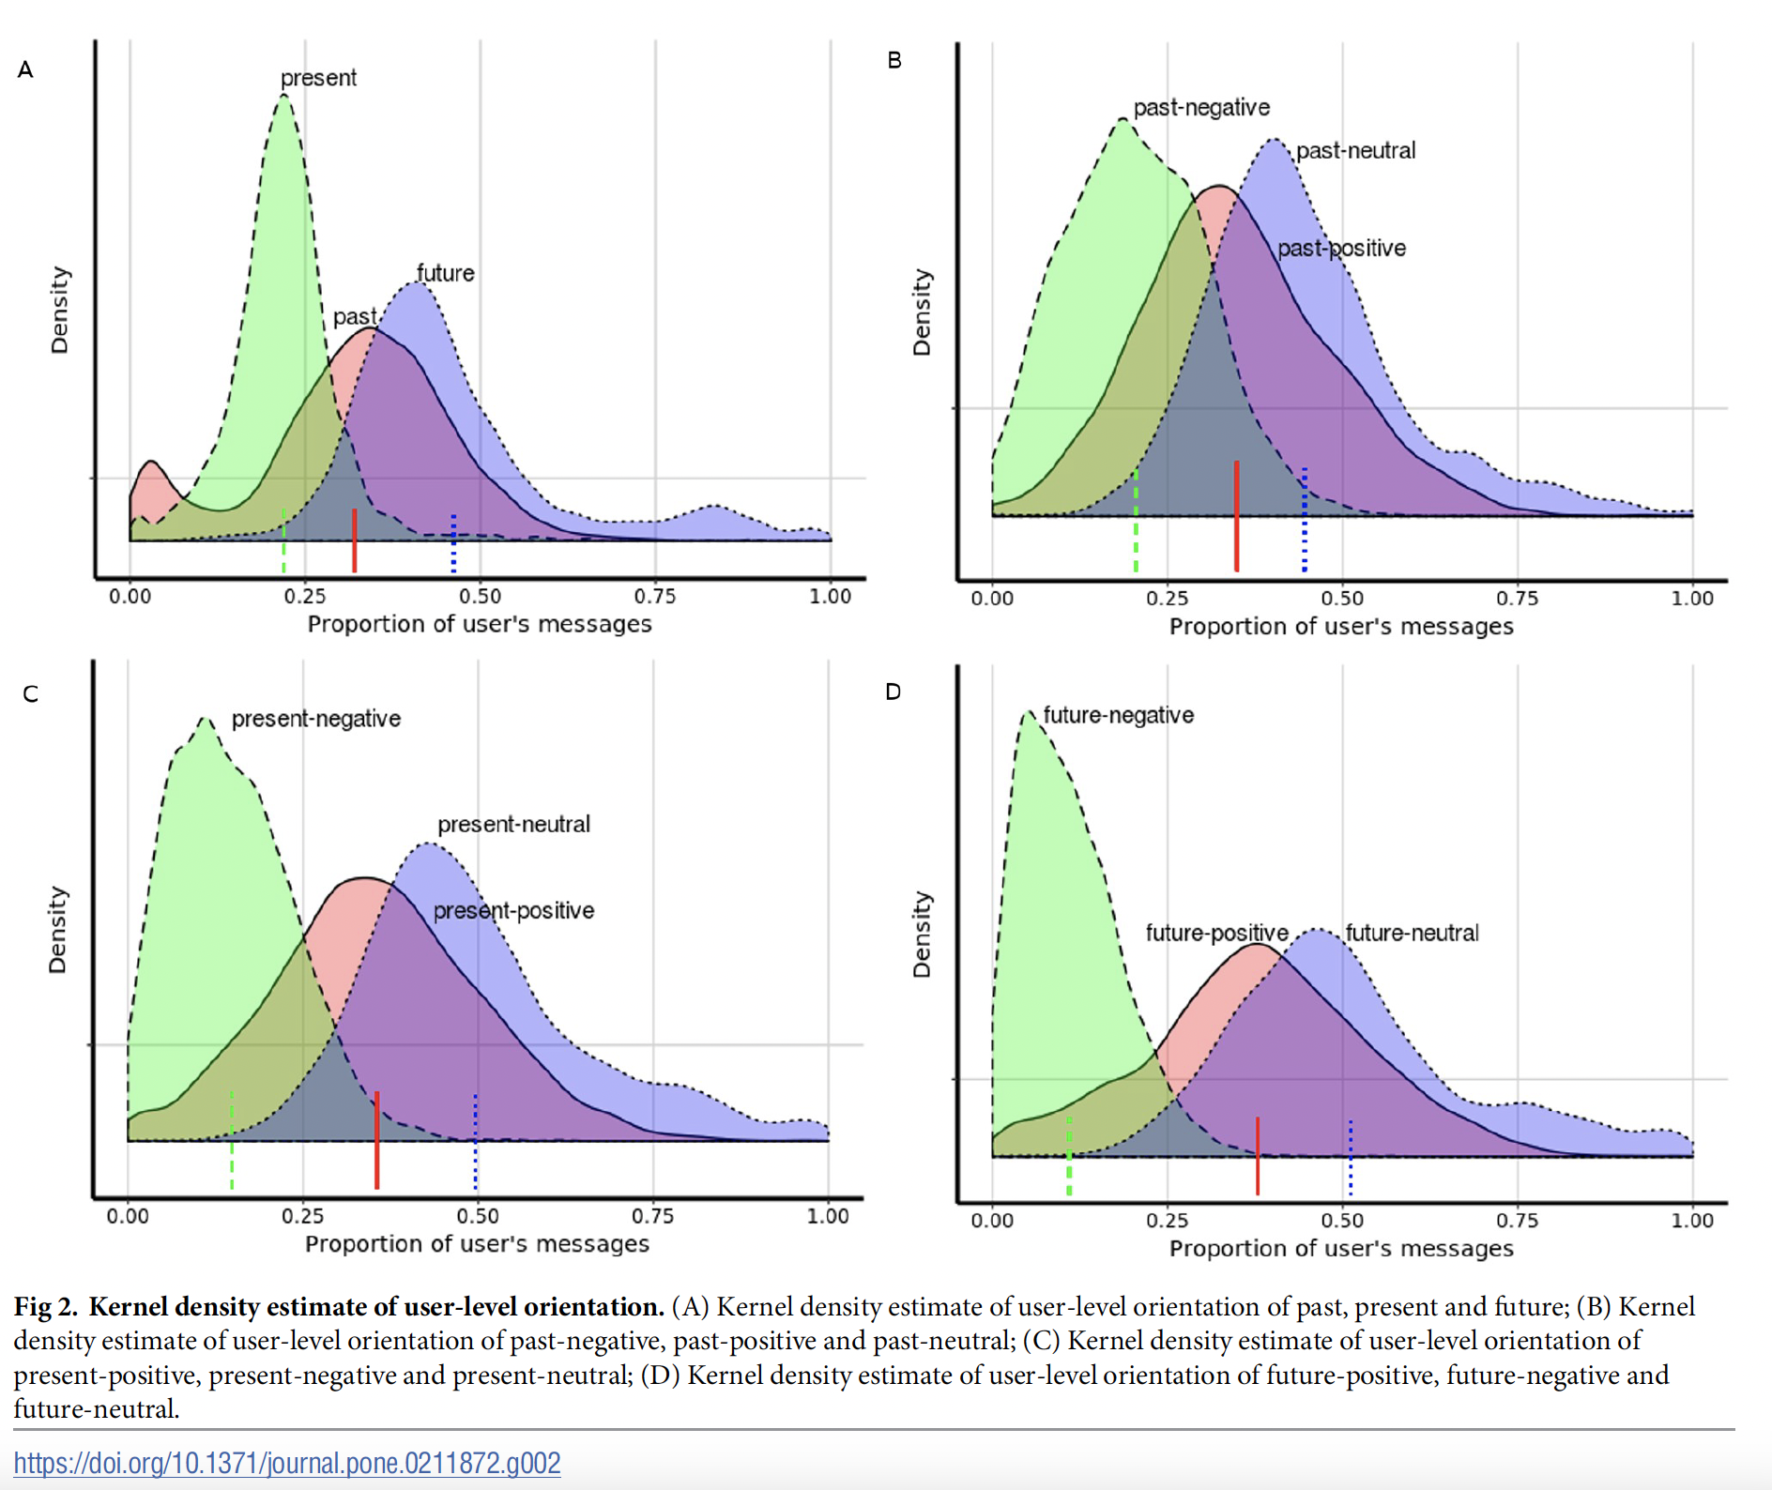
Results
Results of user-level TP
Among most user, the majority of tweets are classified as future.
Past: 0.32
Present: 0.22
Future: 0.46
Within users’ past, present and future orientation
Neutral messages are most frequent while negative messages are less frequent.
Notes:
Among most users, the majority of messages are classified as future, while present-oriented messages are the leasat frequent.
Within user’s past, present and future orientation, neutral messages are most frequent while negative messages were the least frequent.
The Kernel Density Estimation is a mathematic process of finding an estimate probability density function of a random variable. The estimation attempts to infer characteristics of a population, based on a finite data set

Slide 23
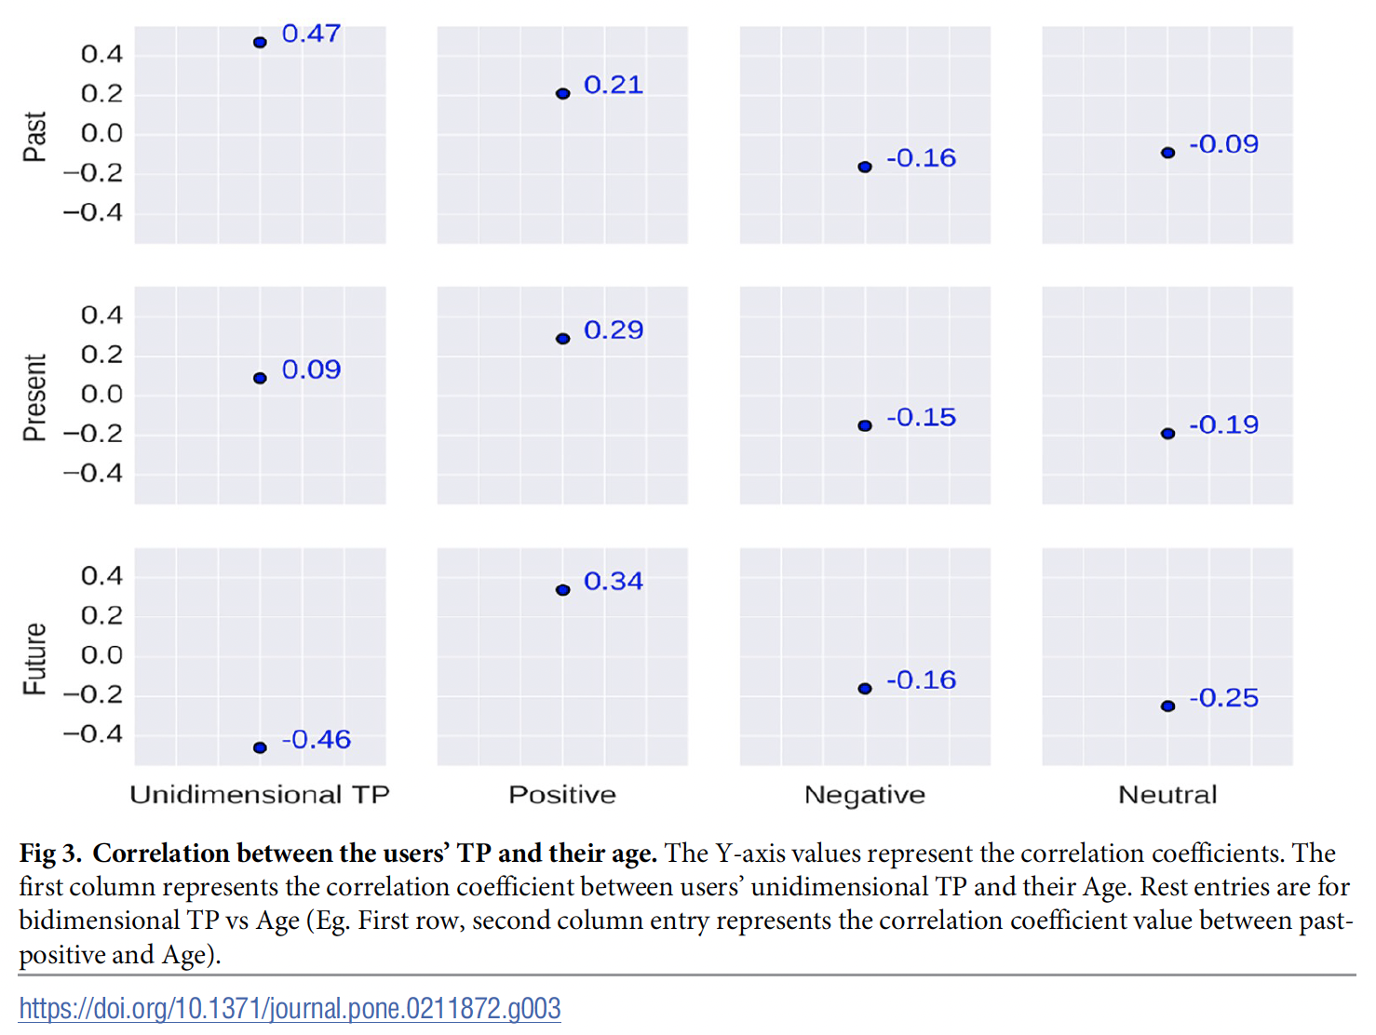
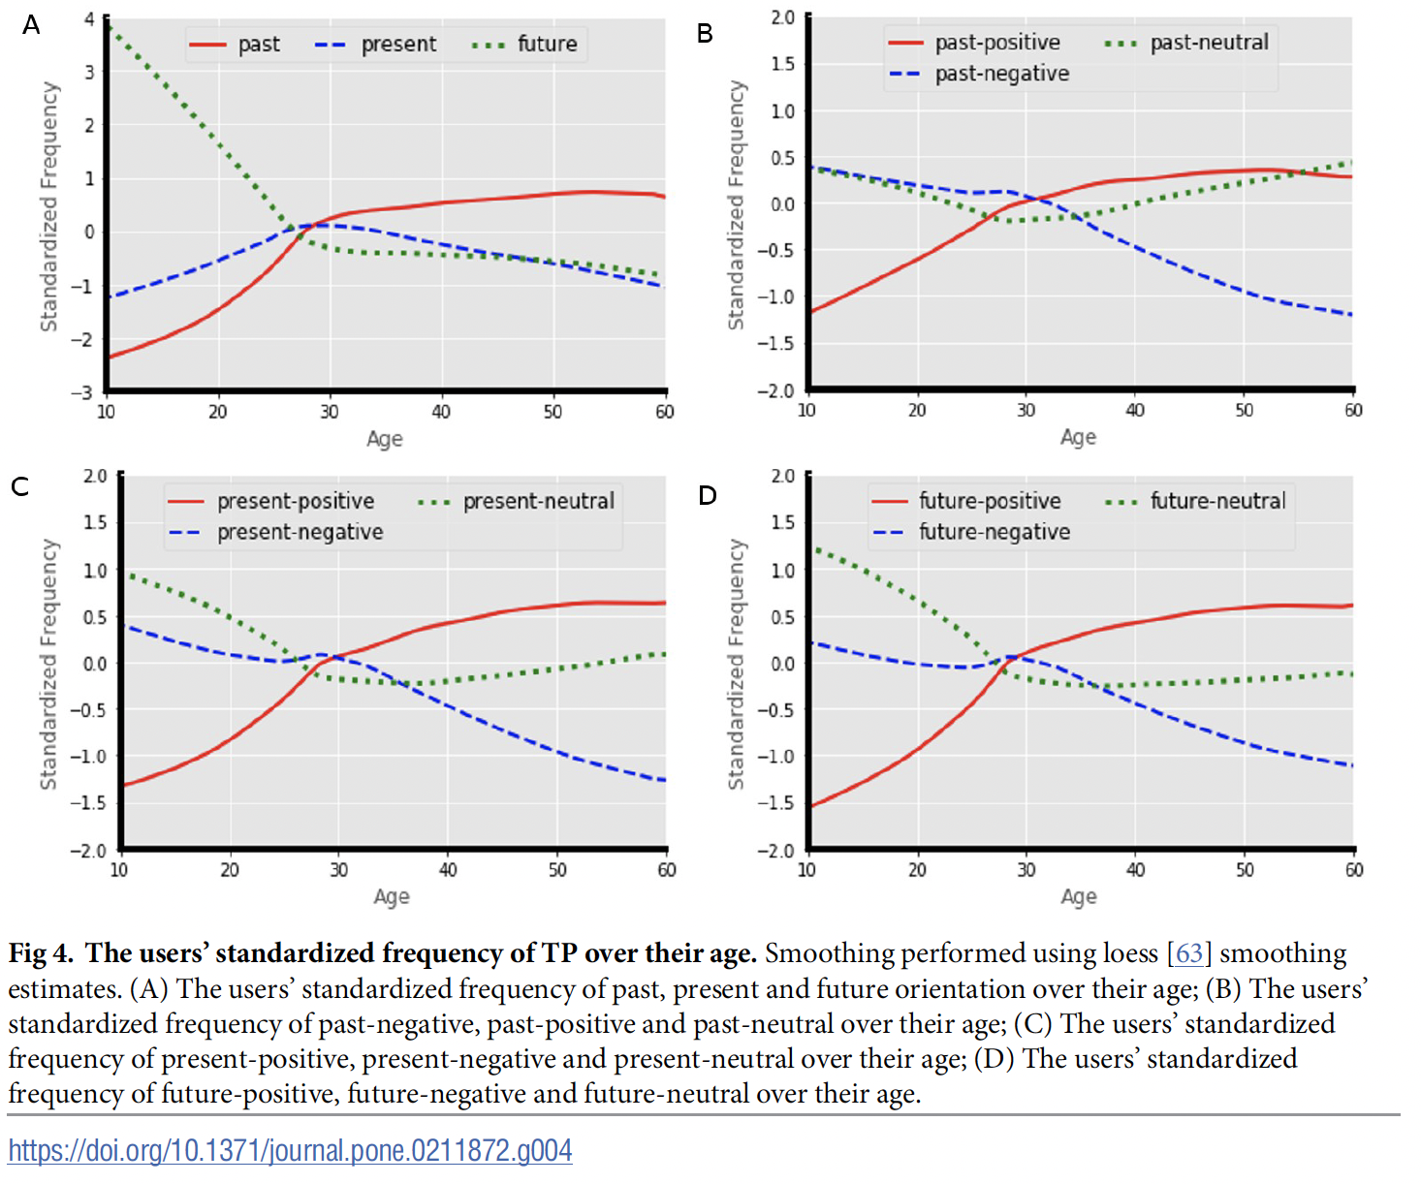
Results
Correlation results and discussion
Fig 3 show correlation between user’s TP and age
Past and unidimensional TP, 0.47
Future and unidimensional TP, -0.47
Future and positive, 0.34
Fig 4 shows user’ standardized frequency of TP over age.
Notes:
Correlation results and discussion
Fig 3 show correlation between user’s TP and age
Highlights
Past and unidimensional TP, 0.47
Signifies that people become past oriented when they age.
Future and unidimensional TP, -0.47
People think less about the future when they age.
Future and positive, 0.34
People become more positive about the future when they age.
Fig 4 shows user’ standardized frequency of TP over age.
We observe in Fig
4A that the trend of users’ temporal orientation changes after the age of 27 to 28. Users’ past
orientation increases sharply until this period and then increases steadily.

Slide 24
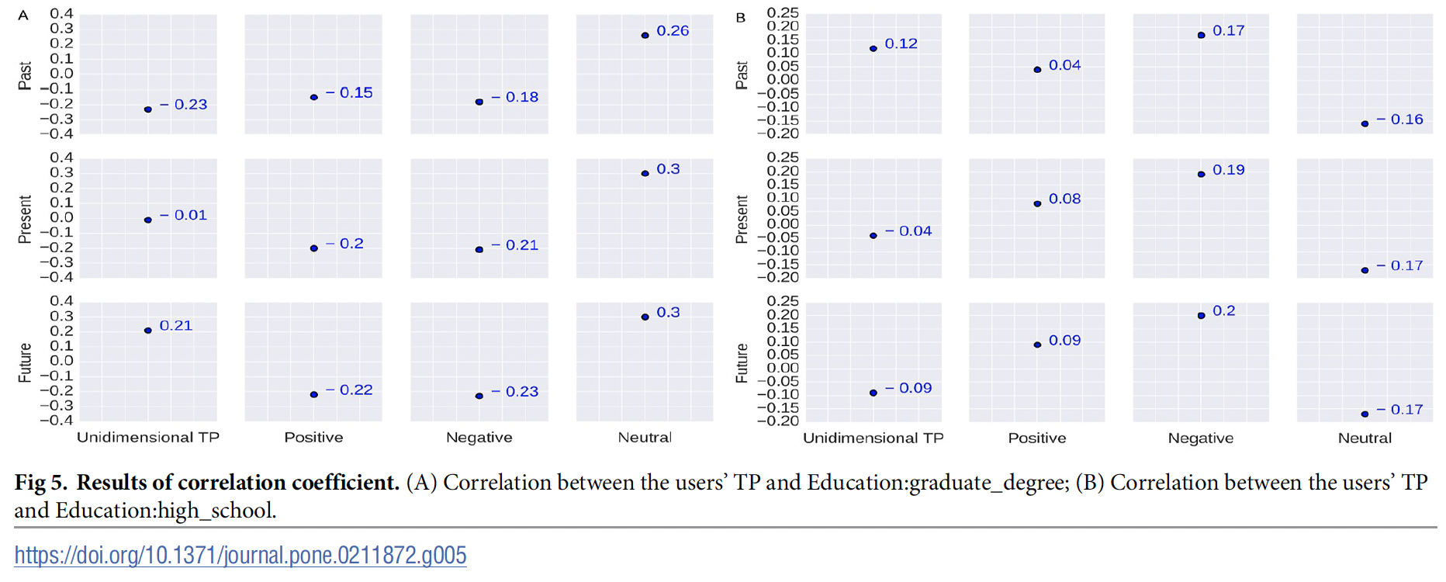
Results
Correlation results and discussion
Fig 5:
Users with graduate degree tend to be future oriented and more neutral about their future
Notes:
Correlation results and discussion
Fig 3 show correlation between user’s TP and age
Highlights
Past and unidimensional TP, 0.47
Signifies that people become past oriented when they age.
Future and unidimensional TP, -0.47
People think less about the future when they age.
Future and positive, 0.34
People become more positive about the future when they age.
Fig 4 shows user’ standardized frequency of TP over age.
We observe in Fig
4A that the trend of users’ temporal orientation changes after the age of 27 to 28. Users’ past
orientation increases sharply until this period and then increases steadily.

Slide 25
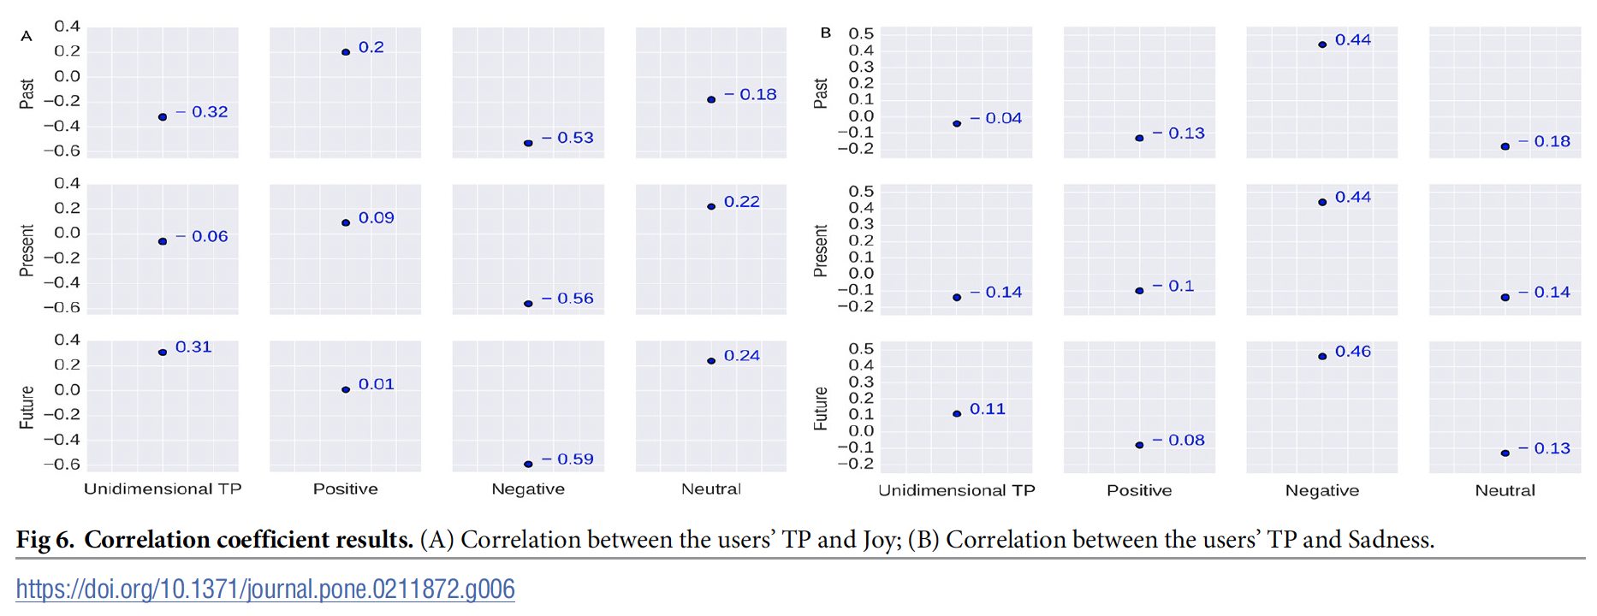
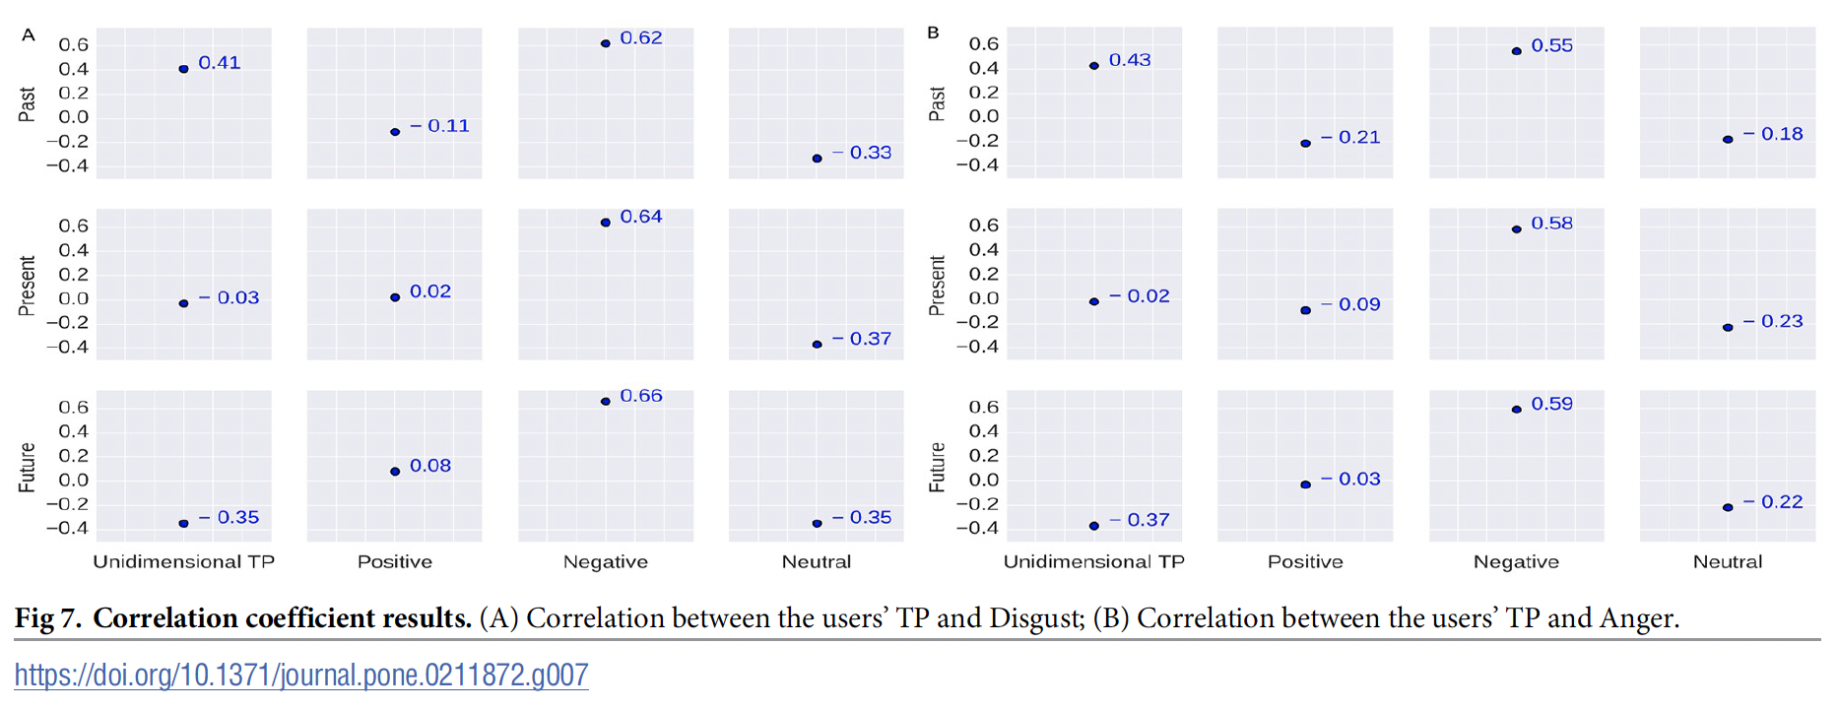
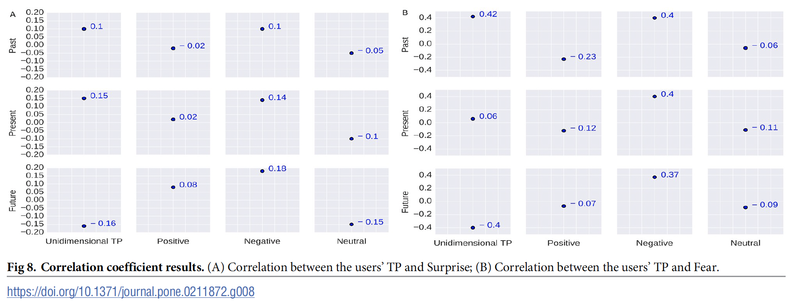
Results
Correlation results and discussion
Fig 6 to Fig 8:
Future negative people tend to be less joyful, sadder, more disgusted and more angry
Past negative people are more fearful
Notes:
We observe in Fig
4A that the trend of users’ temporal orientation changes after the age of 27 to 28. Users’ past
orientation increases sharply until this period and then increases steadily.

Slide 26
Limitations and Future Scope
The paper doesn’t consider an atemporal class where the sentence has no time sense involved.
“The color of this table is red” has no time sense but may be classified as a an instance of the present.
Some sentences have a present time sense, but it may be categorized in a separate class from the present.
”You have this tendency to lie often.”
Some sentences have either present or future orientation depending upon context in which the sentence is used.
“He will think that she is pregnant.”
Our method may suffer in terms of a user’s true identity (fake account).
Demographic correlation subject to differ depending upon demography itself.
Future scope
Work on different demographics, focus on improve performance of temporal orientation classifier and sentiment classifier for this purpose.

Slide 27
Conclusion
The paper presented a first, large-scale study assessing unidimensional and bidimensional TP from social media language.
Extracting actual time information from tweets by tense to time disambiguation become the frontmost task as many tweets grammatical tense and syntactic time is not the same.
Temporal orientation classifier achieved accuracy of 78.8% on a manually annotated test set.
Approach demonstrate that computational techniques can be effectively leveraged to study human cognition like TP.
Introduced bidimensional TP along with unidimensional TP.
Investigated relationship between users’ TP and age, education, and six basic emotions.
Further consideration
How people’s TP changes over their lifetime can be an interesting way to address effects of TP on health and psychology?

Slide 28
References
Zimbardo, P. (2009, June. The psychology of time TED Conferences.
https://www.ted.com/talks/philip_zimbardo_the_psychology_of_time?language=en
https://www.superdatascience.com/blogs/recurrent-neural-networks-rnn-long-short-term-memory-lstm/
https://www.superdatascience.com/blogs/recurrent-neural-networks-rnn-the-vanishing-gradient-problem

